Slide 1
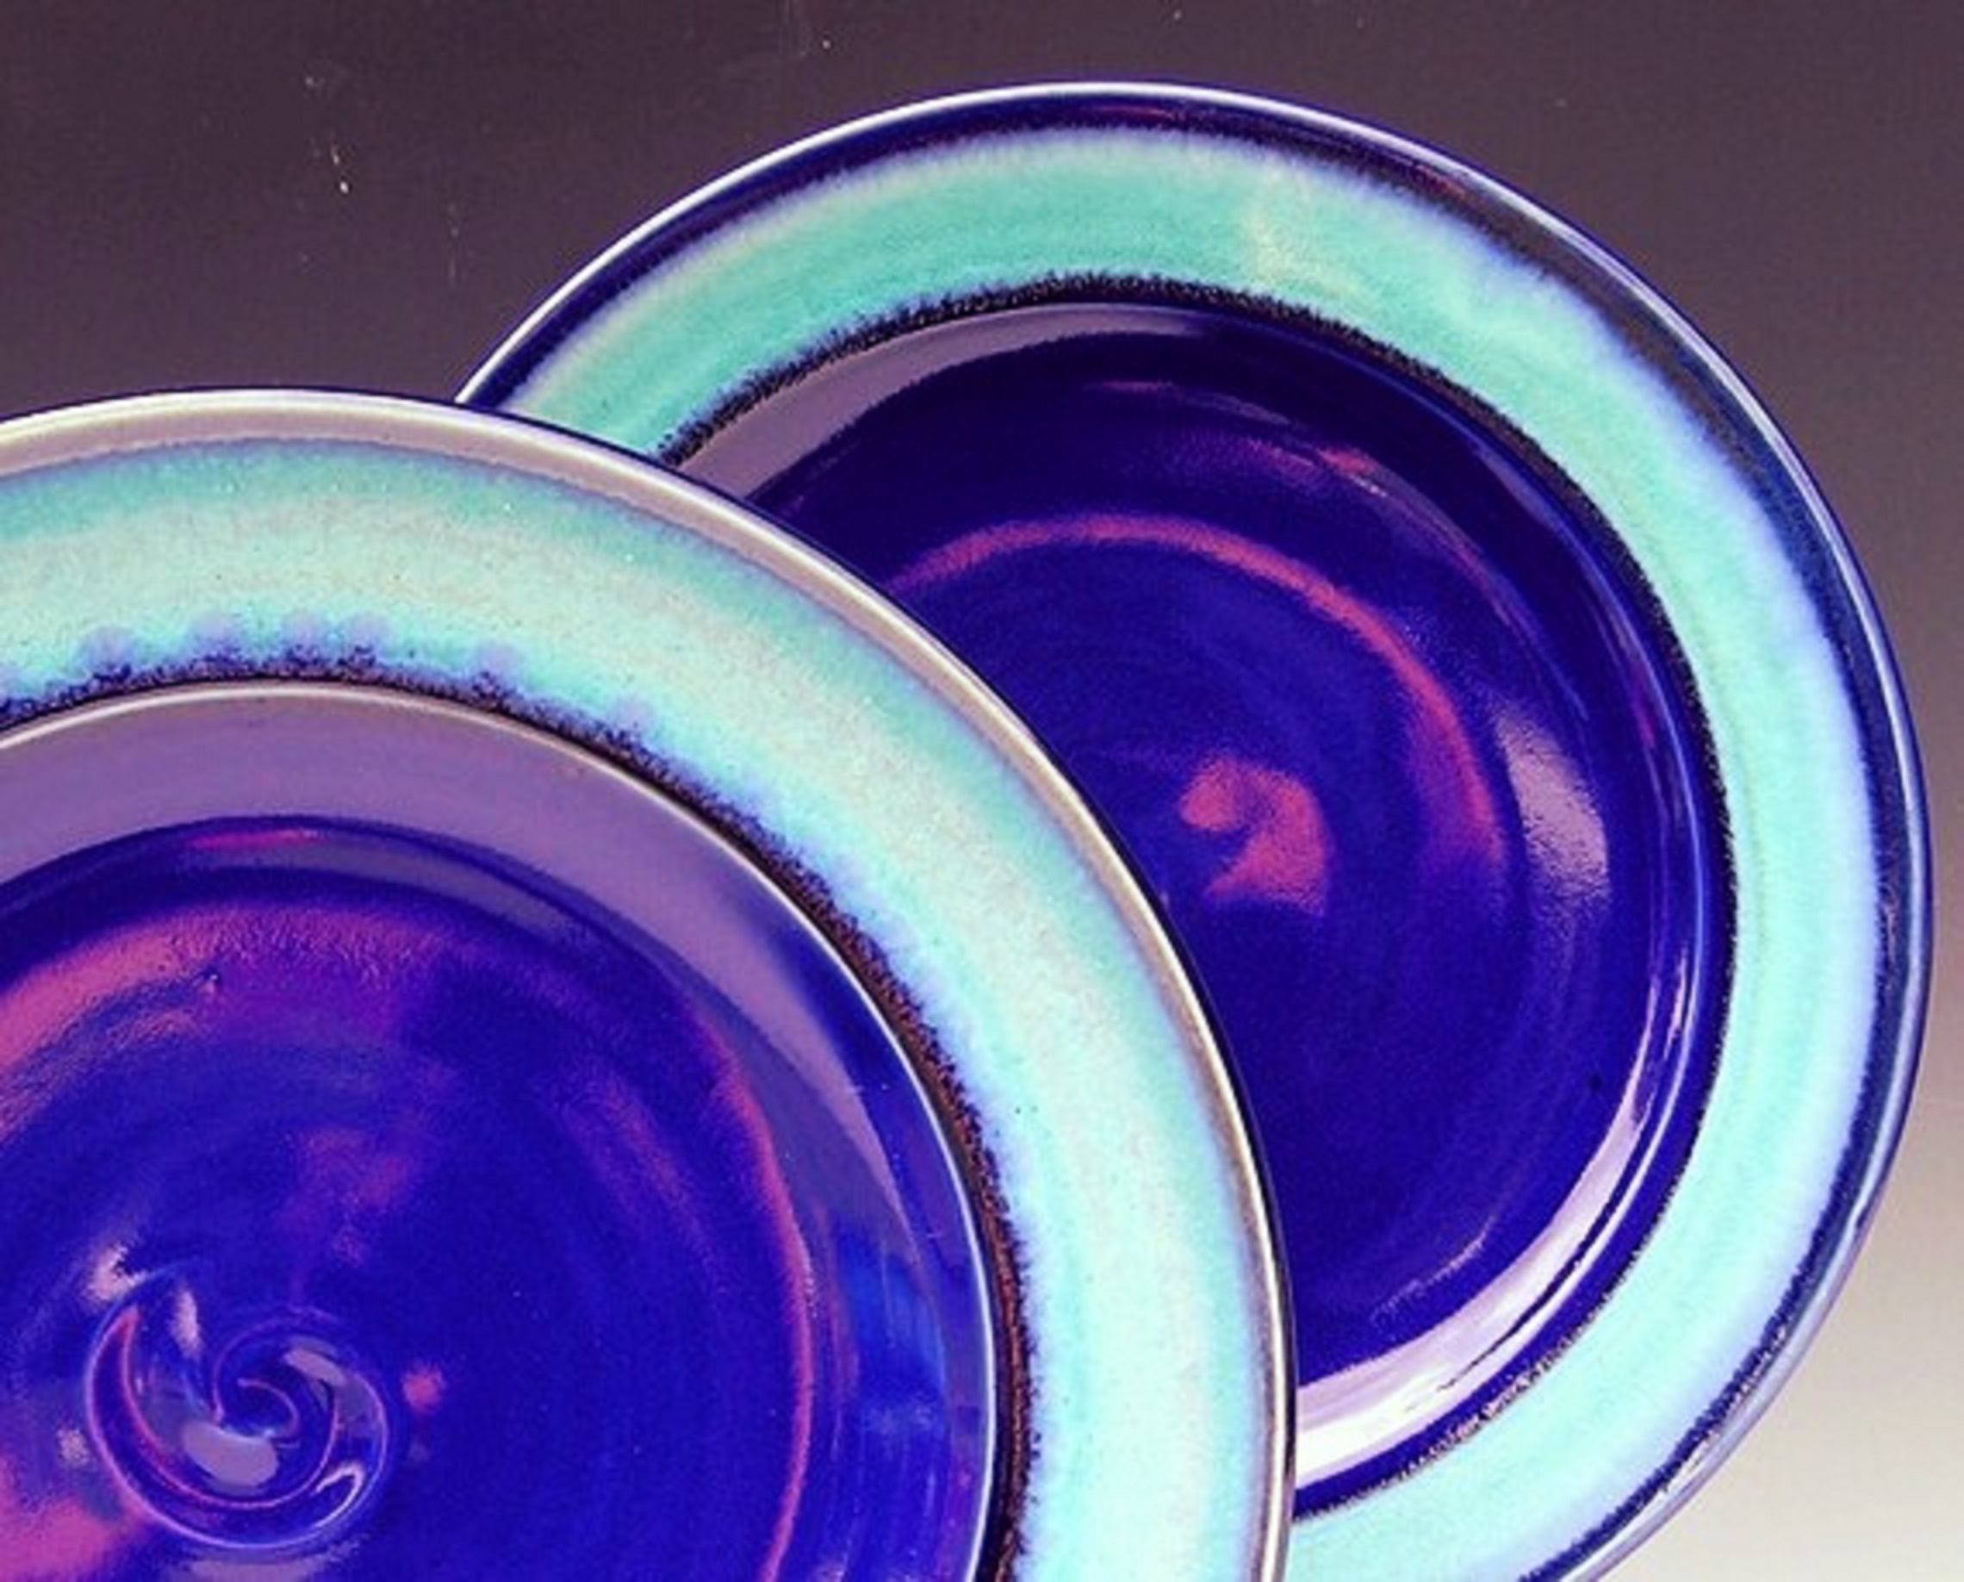
Ahsanullah university of science & tech.
BROKEN CERAMICS
Project: CERAMICS NETWORK

Slide 2
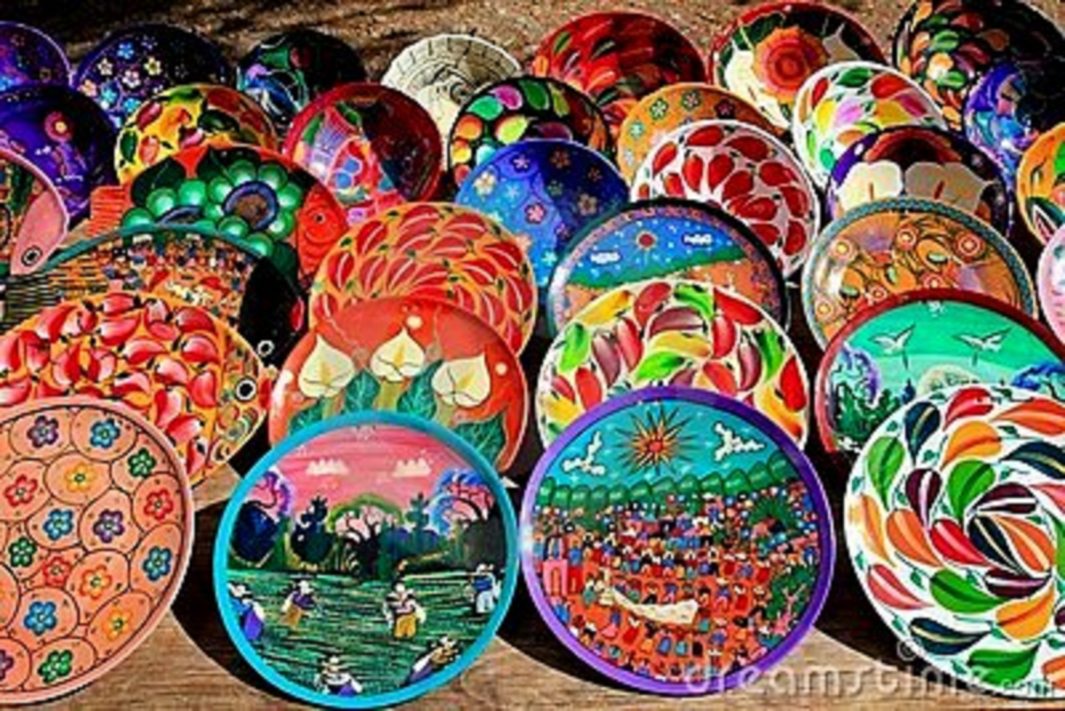
Submitted by:
Submitted to:
Nazmus Sakib
Abdullah Al Jobayer Imran
Rasif Tahmid Islam
ID: 11.01.04.011
A.K.M. Mahmud
ID: 11.01.04.021
Farzana Yeasmeen Sabah
ID: 11.01.04.027
Sumaiya Bushra
ID: 11.01.04.028

Slide 3
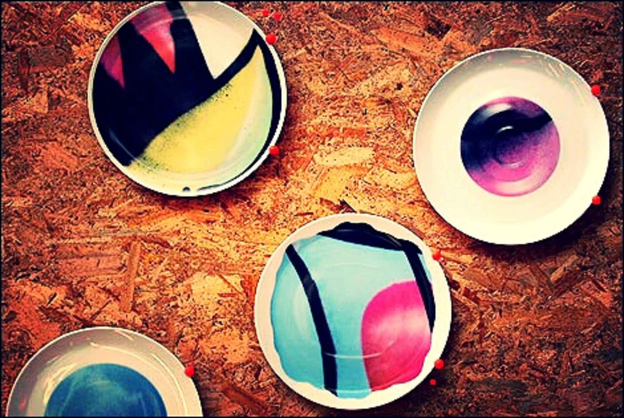
AtTrIBUTeS & tables:
International buyers
IB_ID
IB_Name
Email
Password
Country
Buyer_Company
Local Dealer
LD_ID
LD_Name
Email
Password
Outlet Name
Companies
Company Name
Estd.
Business History
Year
Company Products
Product ID
Company Name
Product Viewers
Price
Image
Product Status
Provide
Product ID
Company Name
Provide date
IB Deals Com.Prod
Deal number
IB ID
Product ID
Deal Date

Slide 4
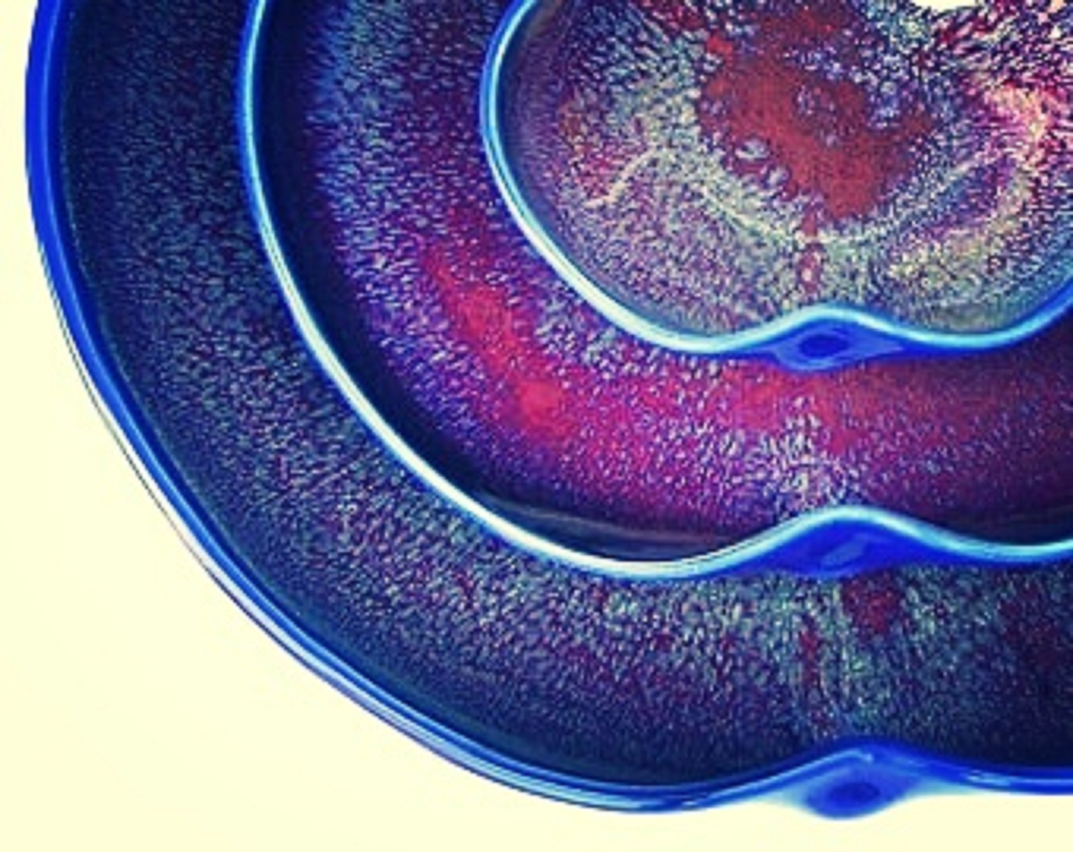
LD Supply Com Prod
Supply Number
LD ID
Product ID
Deal Date
LD Pay Company
LD ID
Supply Number
Company Name
Payment Amount
Payment Date
IB Order Custom Design
Customer Order ID
IB ID
Image
Detail
Similar Product ID
Date
Offer
Customer Order ID
IB ID
Company Name
Price
Review Meetings
IB ID
Company Name
Meeting Date
Time
Place

Slide 5
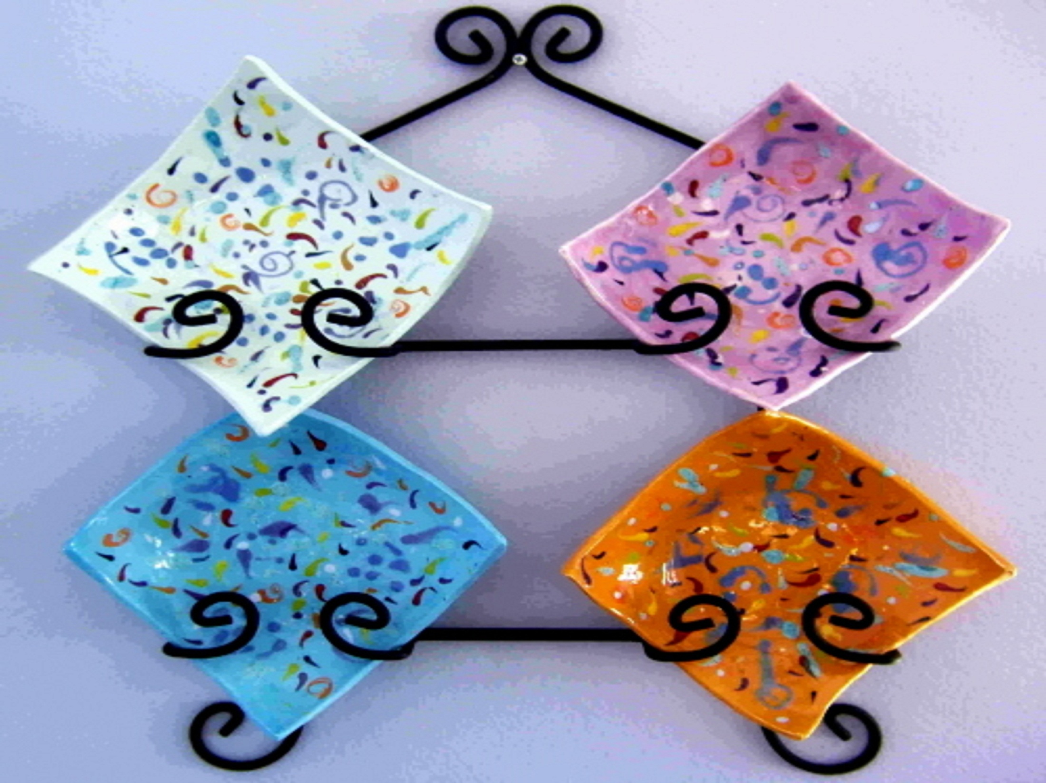
Relation:
Customer Offer,
Deal,
Supply,
Pay,
Provide,
Order Custom Design,
Review Meetings.

Slide 6
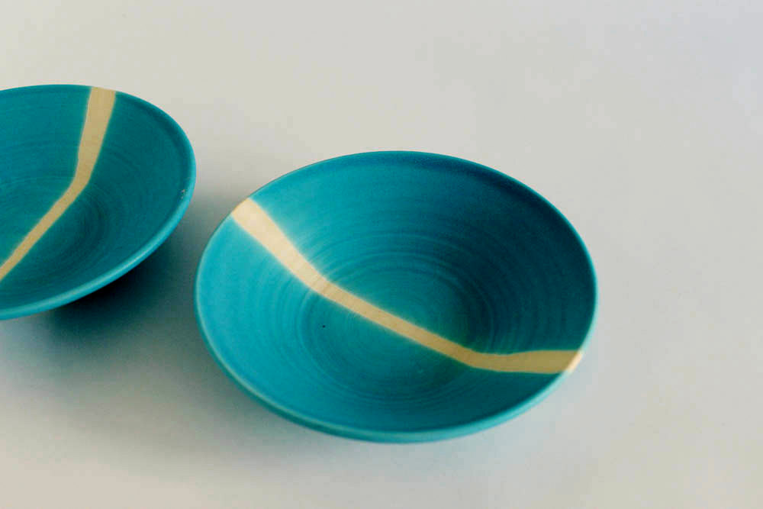
erd

Slide 7
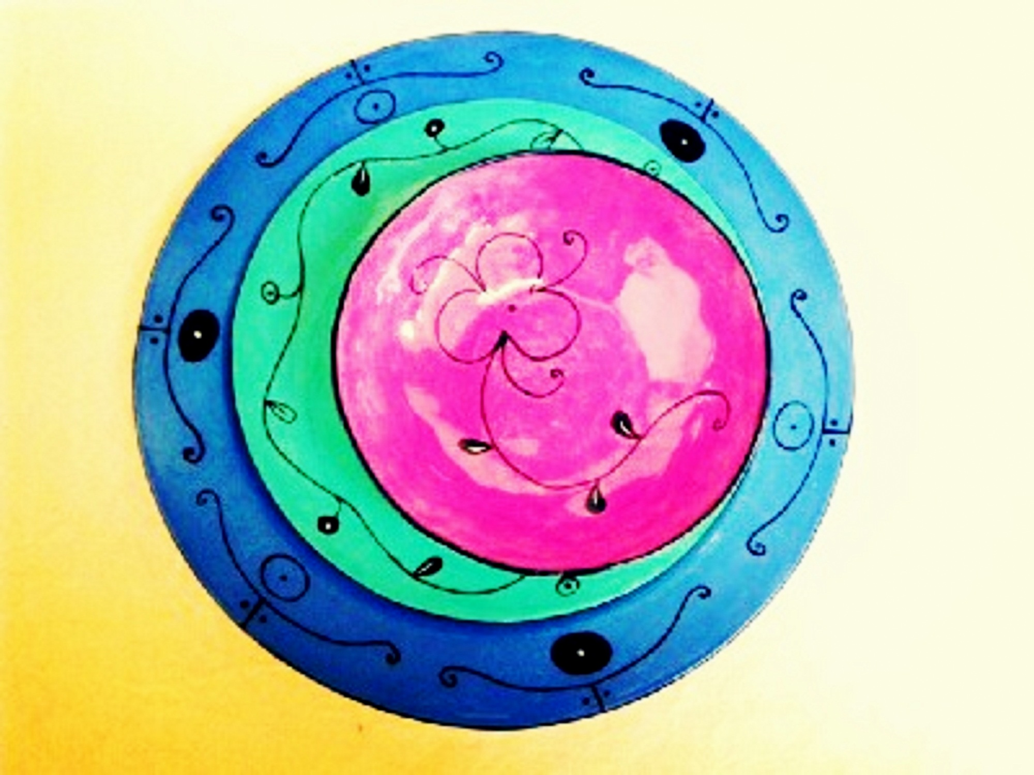
Normalization:
Product ID
Company name
Company Products
Product ID
Company Name
Product Viewers
Price
Image
Product Status
1NF
Product ID
Product Viewers
Price
Image
Product Status

Slide 8
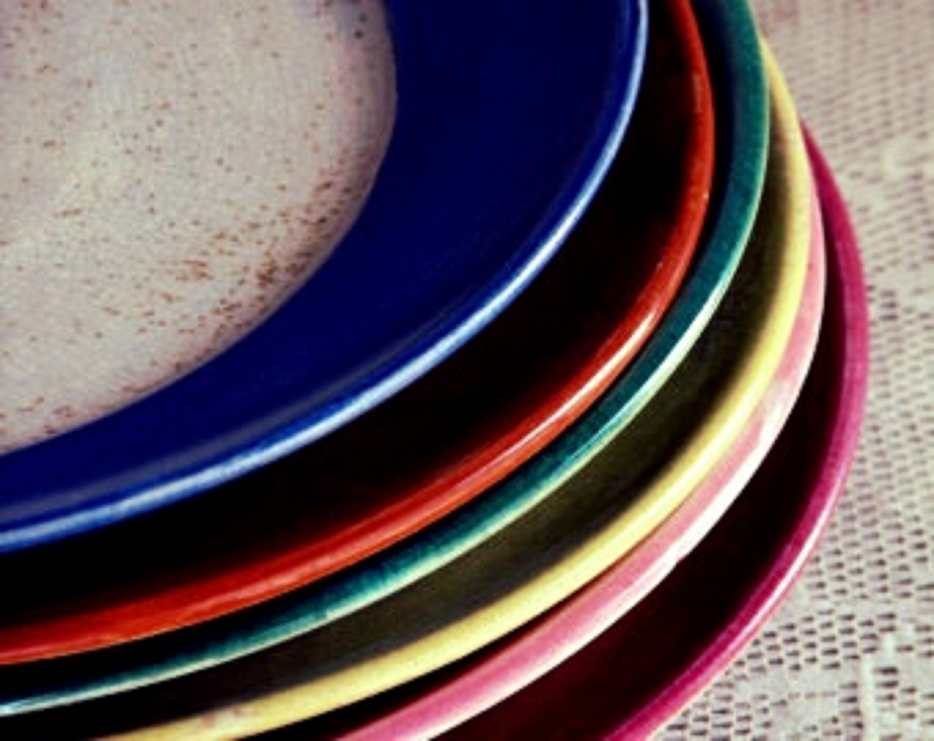
THANK YOU…
ANY QUESTION???

